Slide 1
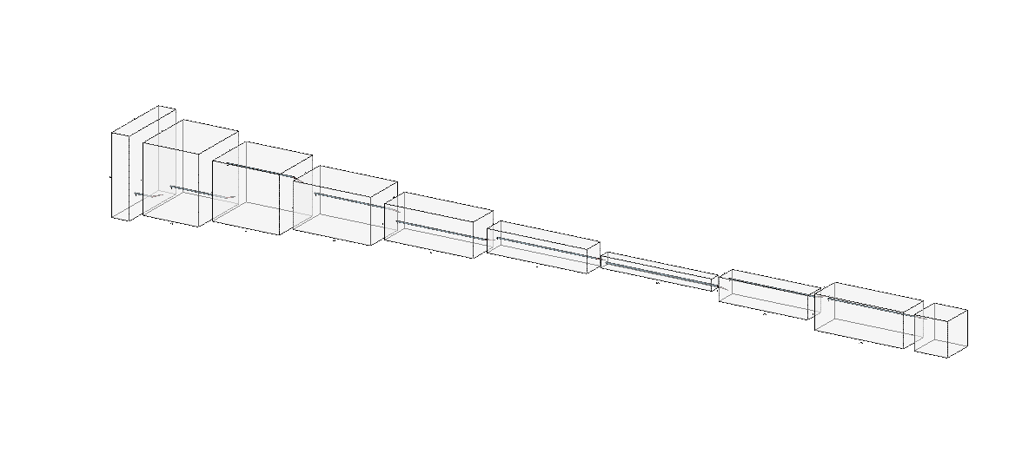
128*128*3
Kernel: (4,4,32)
Stride=2
Padding=1
BatchNorm
ReLU
64*64*32
Kernel: (4,4,64)
Stride=2
Padding=1
BatchNorm
ReLU
32*32*64
Kernel: (4,4,128)
Stride=2
Padding=1
BatchNorm
ReLU
16*16*128
Kernel: (4,4,256)
Stride=2
Padding=1
BatchNorm
ReLU
8*8*256
Kernel: (4,4,512)
Stride=2
Padding=1
BatchNorm
ReLU
4*4*512
Kernel: (4,4,1024)
Stride=2
Padding=1
BatchNorm
ReLU
2*2*1024
Kernel: (4,4,256)
Stride=2
Padding=1
BatchNorm
ReLU
4*4*256
Kernel: (4,4,64)
Stride=2
Padding=1
BatchNorm
ReLU
8*8*64
Kernel: (3,3,8)
Stride=1
Padding=1
8*8*8
Output

